Slide 1




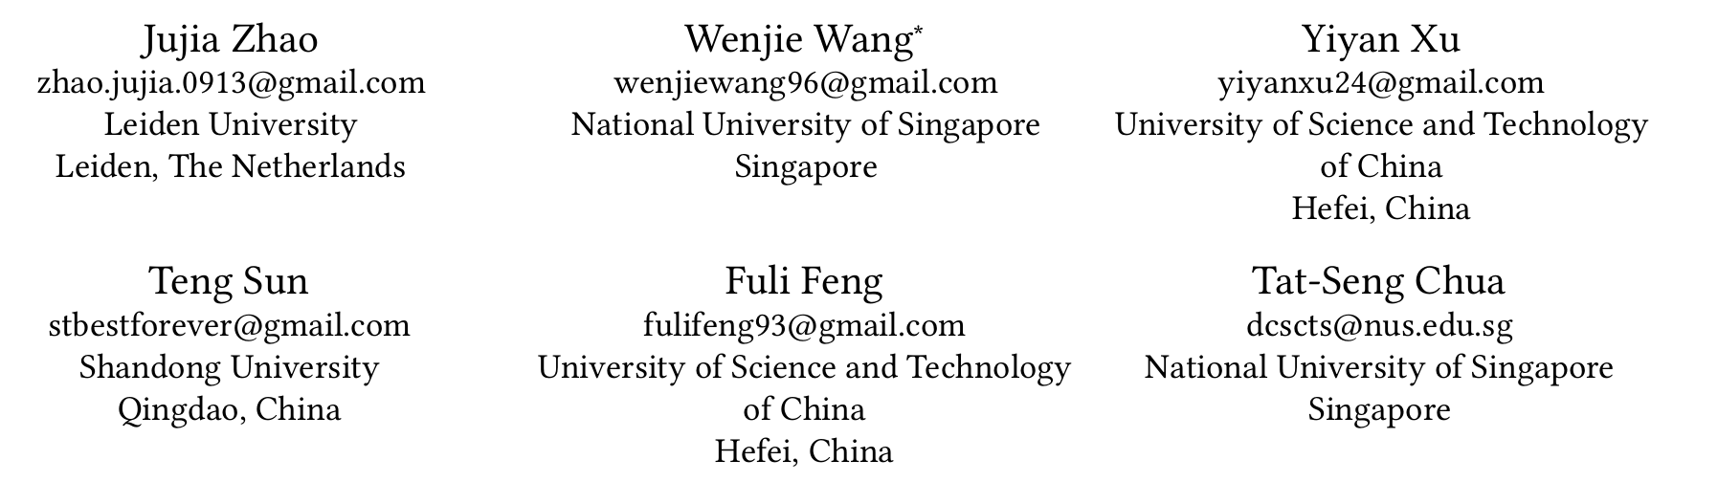





ATAI
Advanced Technique of Artificial Intelligence
ATAI
ChongqingUniversity _{AdvancedTechniqueof}
of Technology Artificial Intelligence
Chongqing University of
Technology
Chongqing University ^{ATAI}
_{of Technology} Advanced Techniqueof
Artificial Intelligence
Chongqing University of Technology
Chongqing University of Technology
Denoising Diffusion Recommender Model
Code : https://github.com/Polaris-JZ/DDRM.
—— SIGIR’2024
Reported by Yang Jiang
1

Slide 2
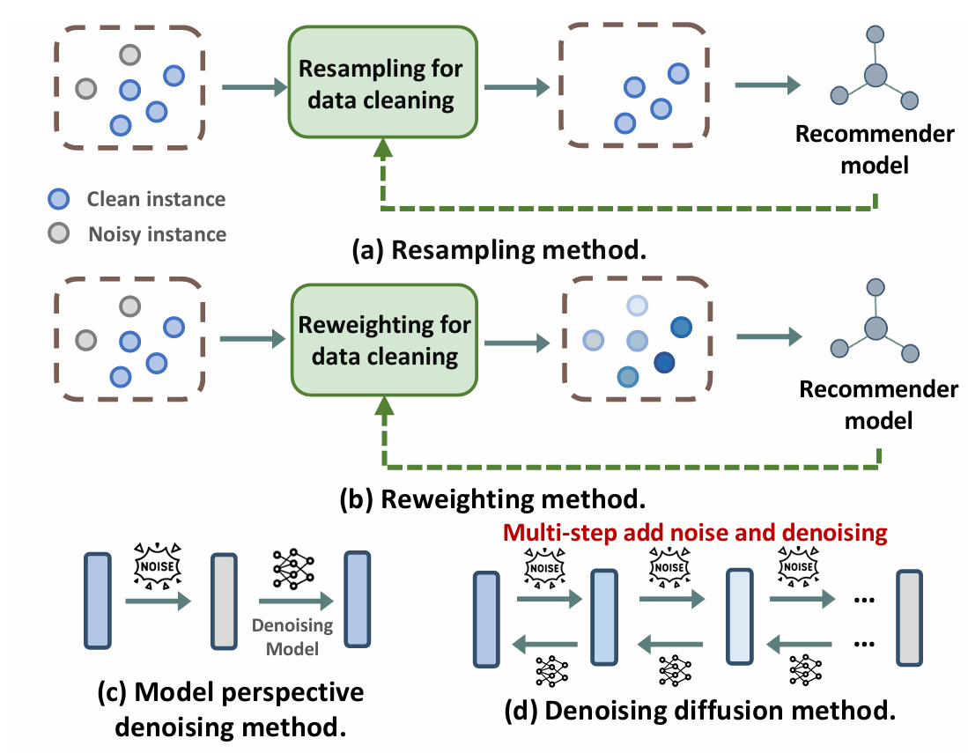
ATAI
Advanced Technique of Artificial Intelligence
ATAI
ChongqingUniversity _{AdvancedTechniqueof}
of Technology Artificial Intelligence
Chongqing University of
Technology
Chongqing University ^{ATAI}
_{of Technology} Advanced Techniqueof
Artificial Intelligence
Chongqing University of Technology
Chongqing University of Technology
Introduction
While most research efforts focus on mitigating noise through data cleaning methods like resampling and reweighting, these approaches often rely on heuristic assumptions.

Slide 3
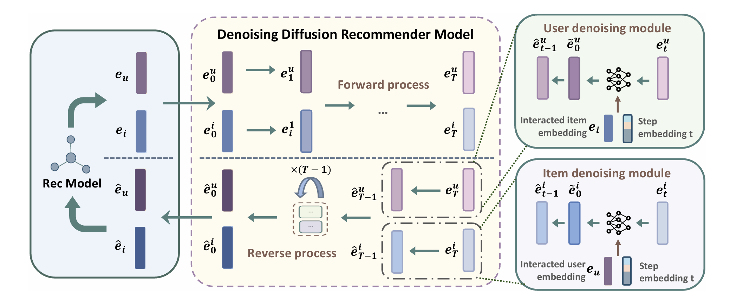
ATAI
Advanced Technique of Artificial Intelligence
ATAI
ChongqingUniversity _{AdvancedTechniqueof}
of Technology Artificial Intelligence
Chongqing University of
Technology
Chongqing University ^{ATAI}
_{of Technology} Advanced Techniqueof
Artificial Intelligence
Chongqing University of Technology
Chongqing University of Technology
Overview

Slide 4
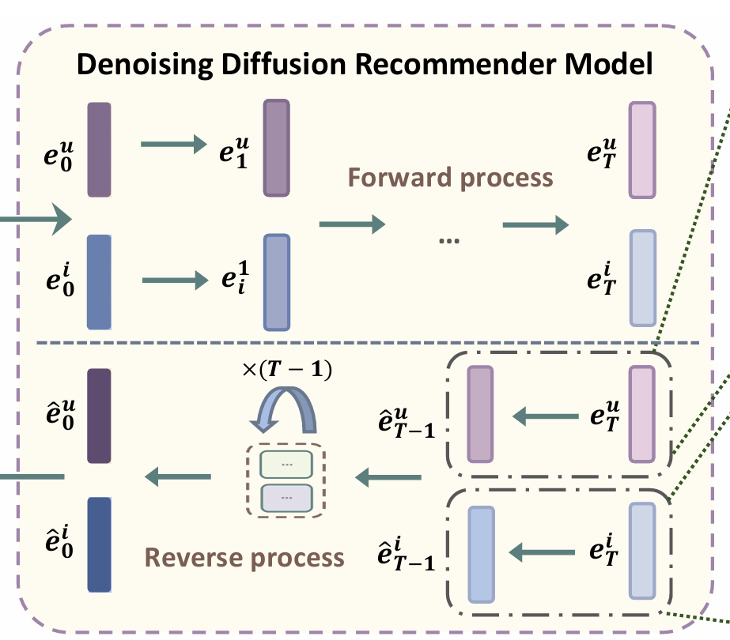
ATAI
Advanced Technique of Artificial Intelligence
ATAI
ChongqingUniversity _{AdvancedTechniqueof}
of Technology Artificial Intelligence
Chongqing University of
Technology
Chongqing University ^{ATAI}
_{of Technology} Advanced Techniqueof
Artificial Intelligence
Chongqing University of Technology
Chongqing University of Technology
Preliminary
Forward process
Reverse process

Slide 5
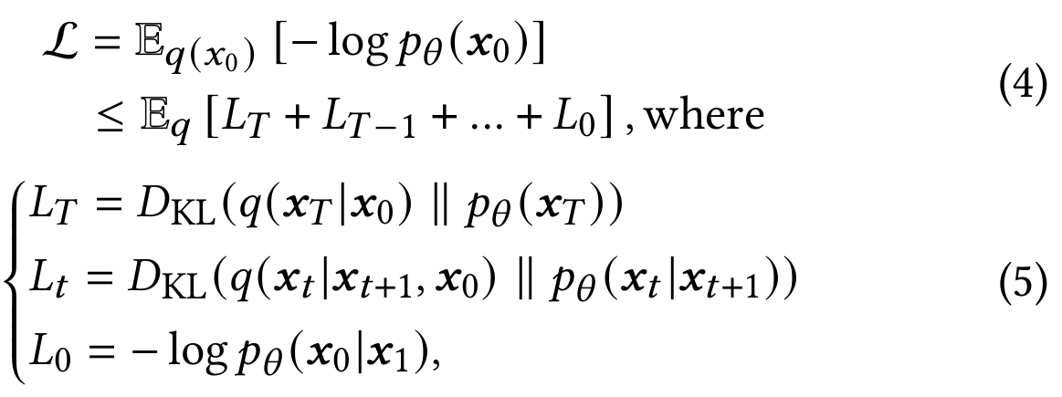
ATAI
Advanced Technique of Artificial Intelligence
ATAI
ChongqingUniversity _{AdvancedTechniqueof}
of Technology Artificial Intelligence
Chongqing University of
Technology
Chongqing University ^{ATAI}
_{of Technology} Advanced Techniqueof
Artificial Intelligence
Chongqing University of Technology
Chongqing University of Technology
Preliminary
Training

Slide 6
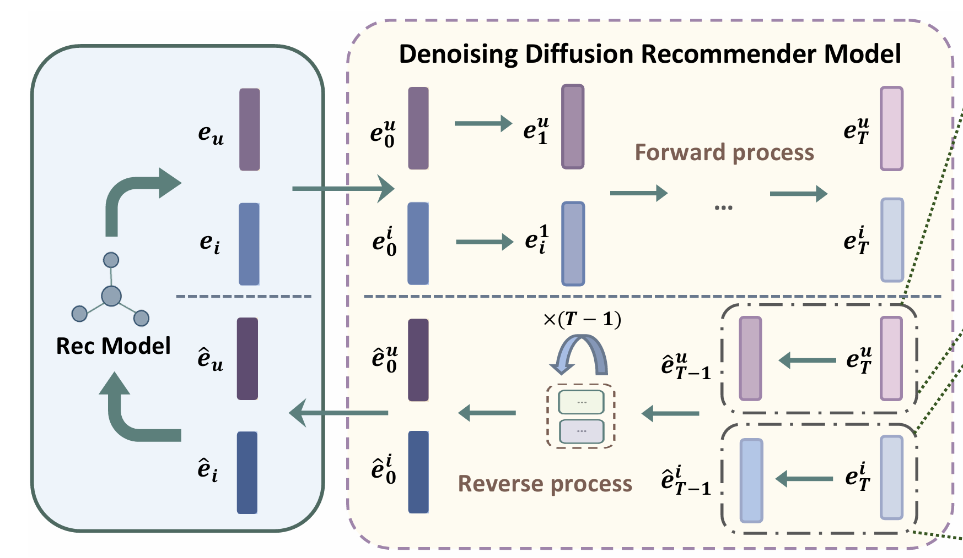
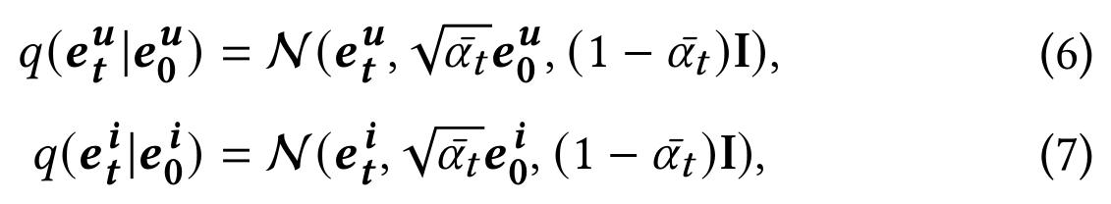
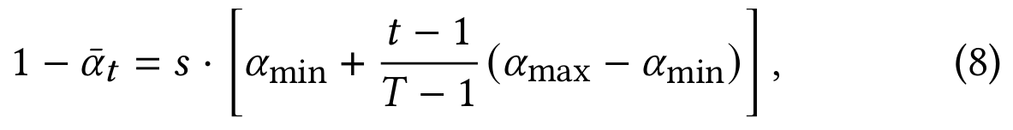
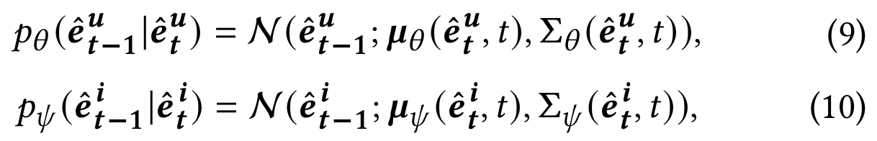
ATAI
Advanced Technique of Artificial Intelligence
ATAI
ChongqingUniversity _{AdvancedTechniqueof}
of Technology Artificial Intelligence
Chongqing University of
Technology
Chongqing University ^{ATAI}
_{of Technology} Advanced Techniqueof
Artificial Intelligence
Chongqing University of Technology
Chongqing University of Technology
Method
Forward process
Reverse process

Slide 7
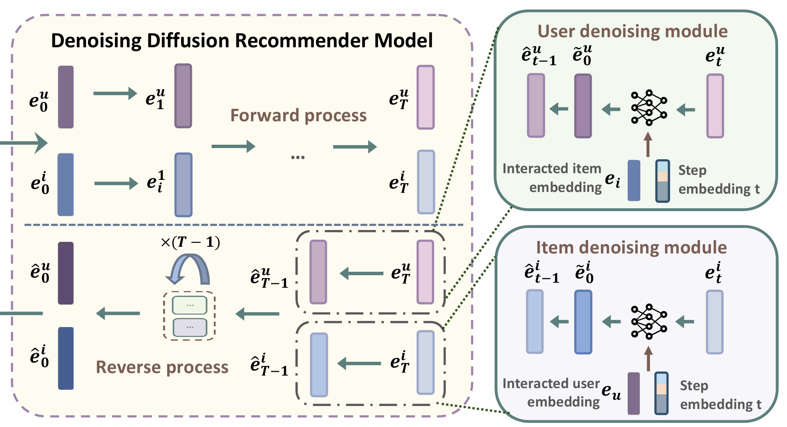
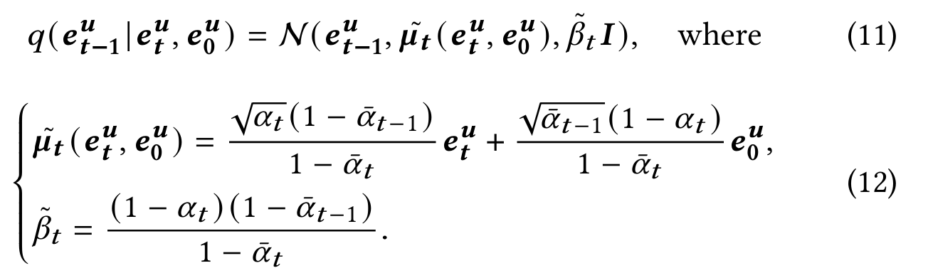
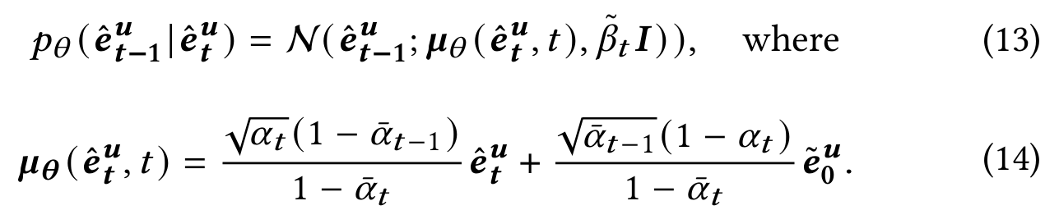
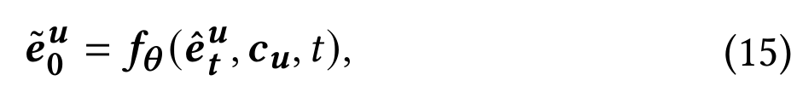
ATAI
Advanced Technique of Artificial Intelligence
ATAI
ChongqingUniversity _{AdvancedTechniqueof}
of Technology Artificial Intelligence
Chongqing University of
Technology
Chongqing University ^{ATAI}
_{of Technology} Advanced Techniqueof
Artificial Intelligence
Chongqing University of Technology
Chongqing University of Technology
Method
Denoising module

Slide 8
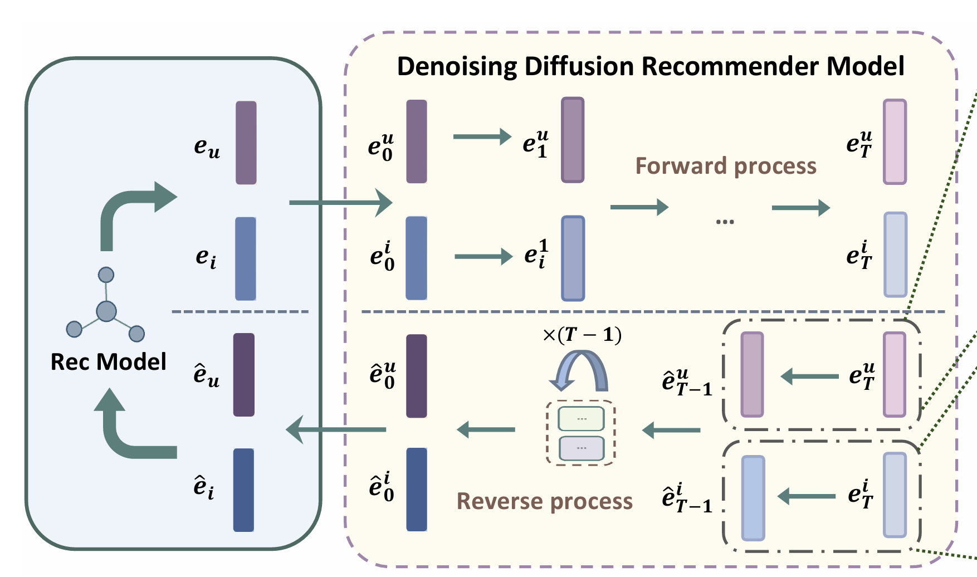
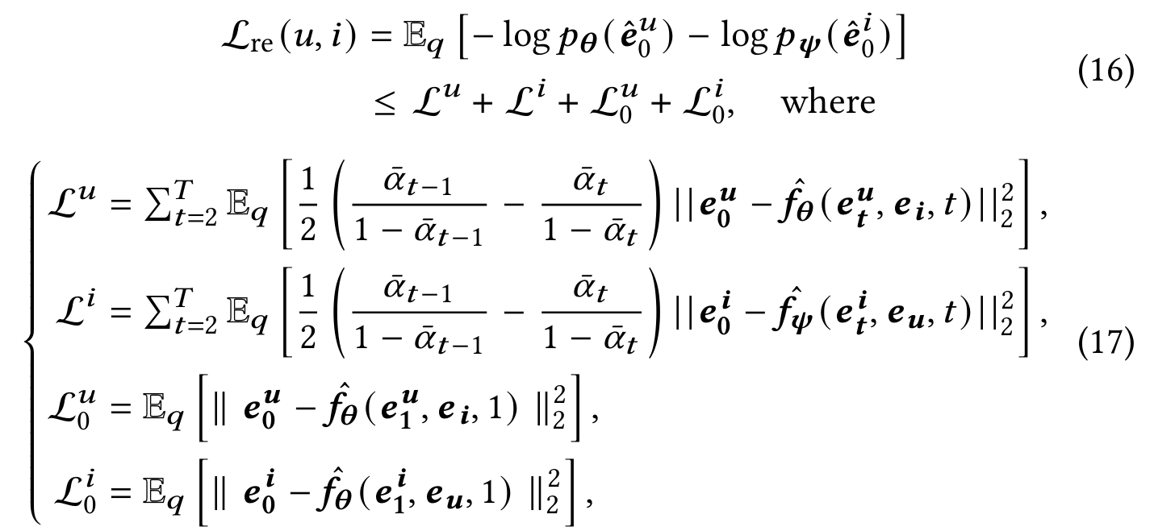
ATAI
Advanced Technique of Artificial Intelligence
ATAI
ChongqingUniversity _{AdvancedTechniqueof}
of Technology Artificial Intelligence
Chongqing University of
Technology
Chongqing University ^{ATAI}
_{of Technology} Advanced Techniqueof
Artificial Intelligence
Chongqing University of Technology
Chongqing University of Technology
Method

Slide 9
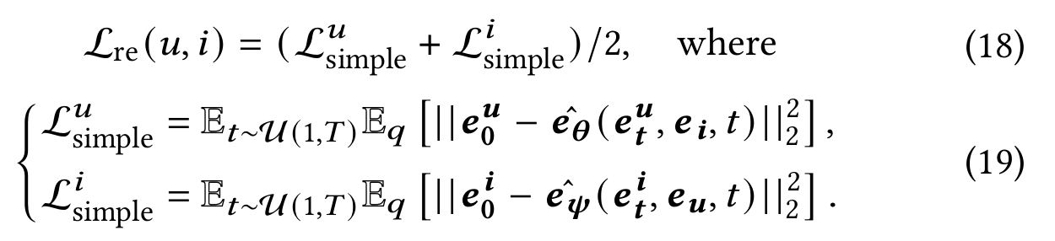
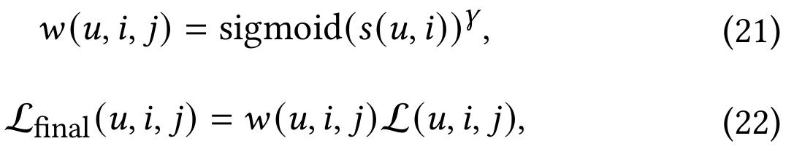
ATAI
Advanced Technique of Artificial Intelligence
ATAI
ChongqingUniversity _{AdvancedTechniqueof}
of Technology Artificial Intelligence
Chongqing University of
Technology
Chongqing University ^{ATAI}
_{of Technology} Advanced Techniqueof
Artificial Intelligence
Chongqing University of Technology
Chongqing University of Technology
Method

Slide 10
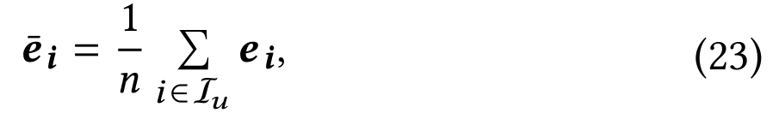
ATAI
Advanced Technique of Artificial Intelligence
ATAI
ChongqingUniversity _{AdvancedTechniqueof}
of Technology Artificial Intelligence
Chongqing University of
Technology
Chongqing University ^{ATAI}
_{of Technology} Advanced Techniqueof
Artificial Intelligence
Chongqing University of Technology
Chongqing University of Technology
Method

Slide 11
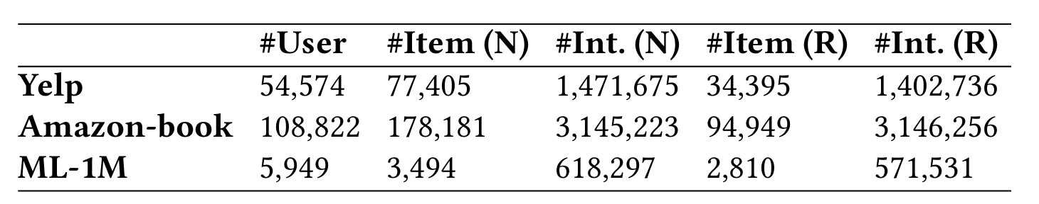
ATAI
Advanced Technique of Artificial Intelligence
ATAI
ChongqingUniversity _{AdvancedTechniqueof}
of Technology Artificial Intelligence
Chongqing University of
Technology
Chongqing University ^{ATAI}
_{of Technology} Advanced Techniqueof
Artificial Intelligence
Chongqing University of Technology
Chongqing University of Technology
Experiments

Slide 12
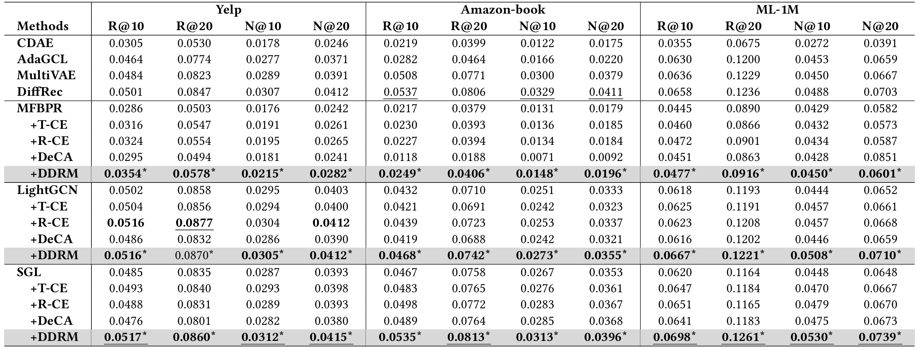
ATAI
Advanced Technique of Artificial Intelligence
ATAI
ChongqingUniversity _{AdvancedTechniqueof}
of Technology Artificial Intelligence
Chongqing University of
Technology
Chongqing University ^{ATAI}
_{of Technology} Advanced Techniqueof
Artificial Intelligence
Chongqing University of Technology
Chongqing University of Technology
Experiments

Slide 13
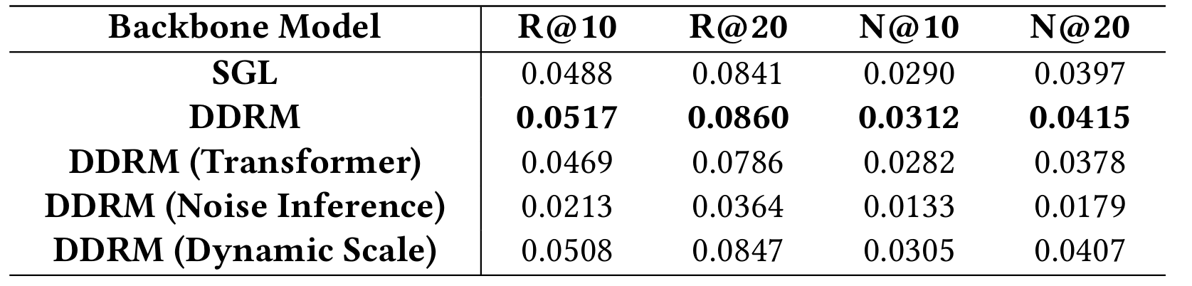
ATAI
Advanced Technique of Artificial Intelligence
ATAI
ChongqingUniversity _{AdvancedTechniqueof}
of Technology Artificial Intelligence
Chongqing University of
Technology
Chongqing University ^{ATAI}
_{of Technology} Advanced Techniqueof
Artificial Intelligence
Chongqing University of Technology
Chongqing University of Technology
Experiments

Slide 14
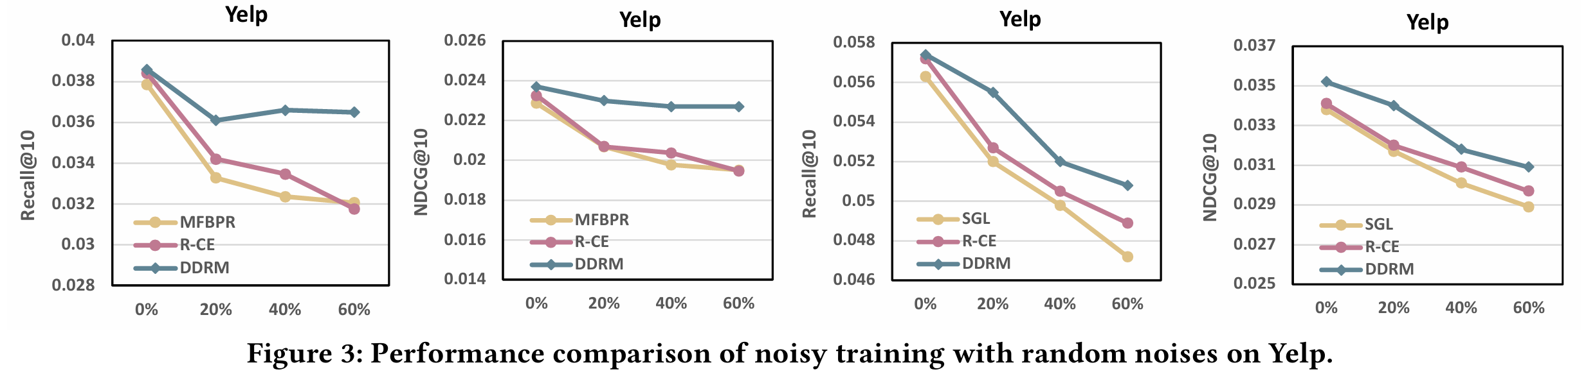
ATAI
Advanced Technique of Artificial Intelligence
ATAI
ChongqingUniversity _{AdvancedTechniqueof}
of Technology Artificial Intelligence
Chongqing University of
Technology
Chongqing University ^{ATAI}
_{of Technology} Advanced Techniqueof
Artificial Intelligence
Chongqing University of Technology
Chongqing University of Technology
Experiments

Slide 15
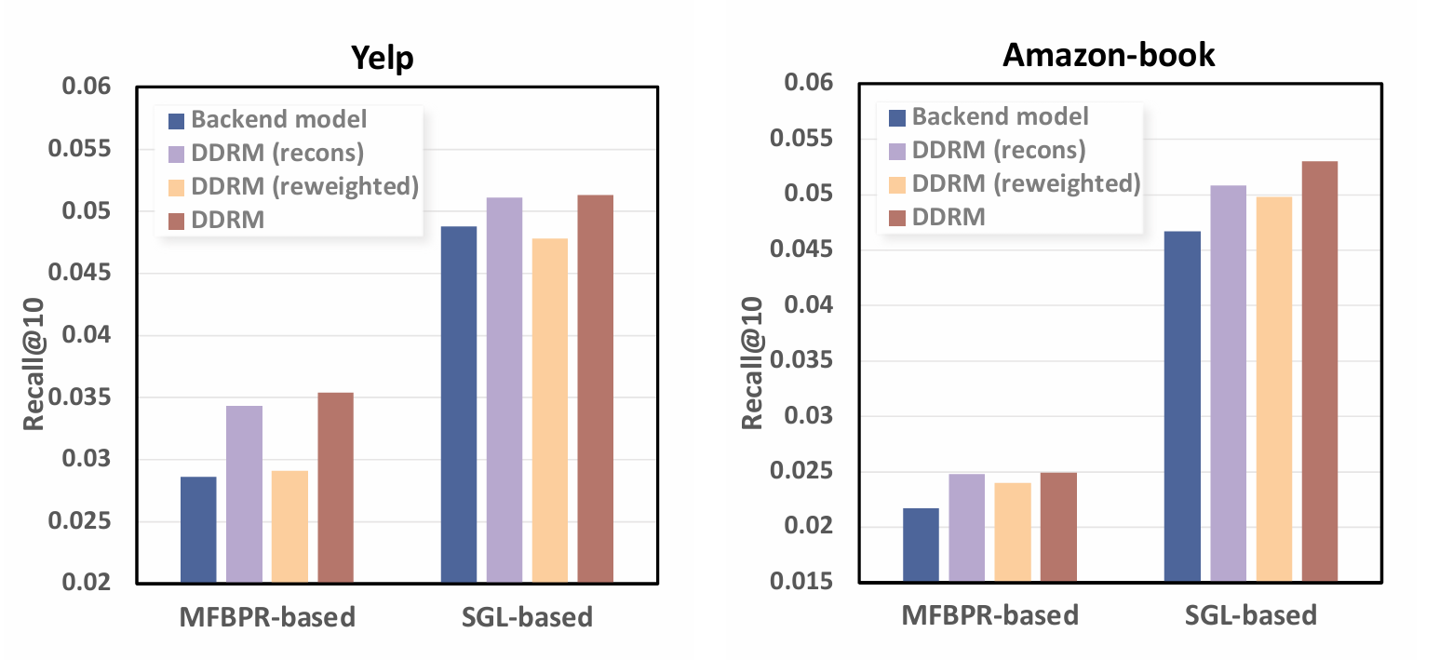
ATAI
Advanced Technique of Artificial Intelligence
ATAI
ChongqingUniversity _{AdvancedTechniqueof}
of Technology Artificial Intelligence
Chongqing University of
Technology
Chongqing University ^{ATAI}
_{of Technology} Advanced Techniqueof
Artificial Intelligence
Chongqing University of Technology
Chongqing University of Technology
Experiments

Slide 16
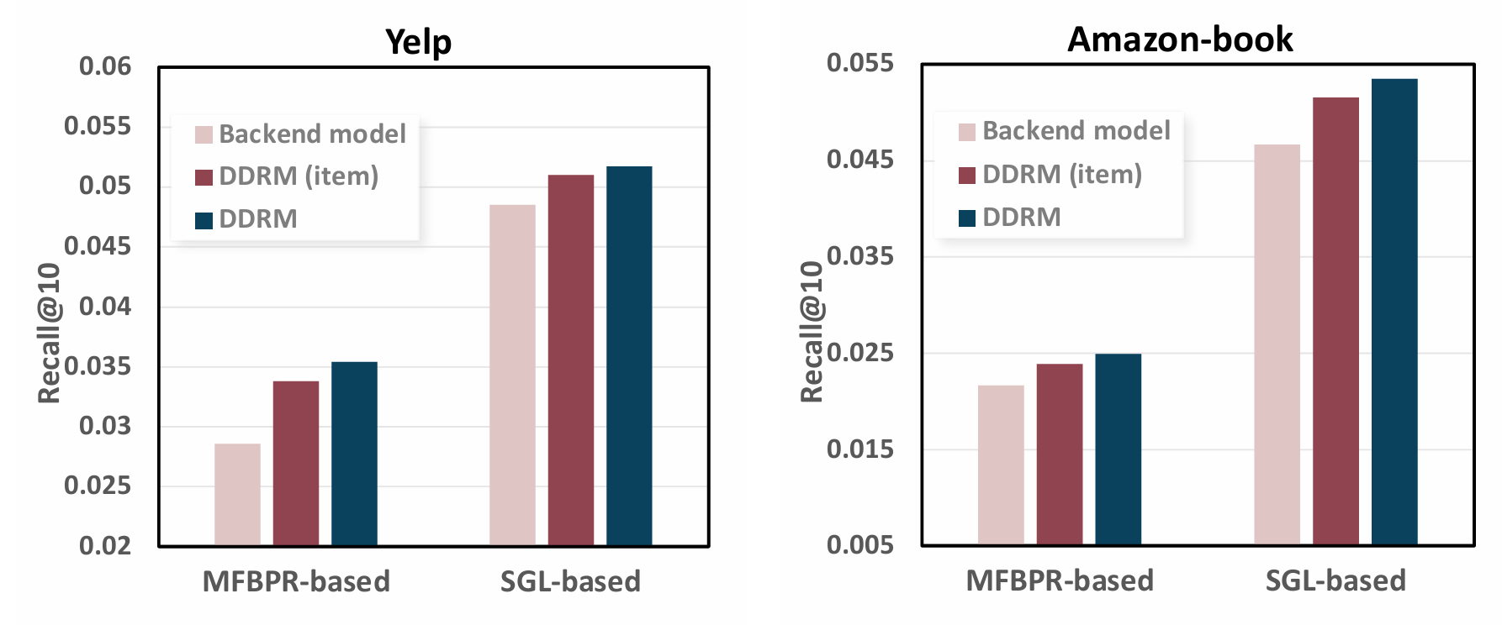
ATAI
Advanced Technique of Artificial Intelligence
ATAI
ChongqingUniversity _{AdvancedTechniqueof}
of Technology Artificial Intelligence
Chongqing University of
Technology
Chongqing University ^{ATAI}
_{of Technology} Advanced Techniqueof
Artificial Intelligence
Chongqing University of Technology
Chongqing University of Technology
Experiments

Slide 17
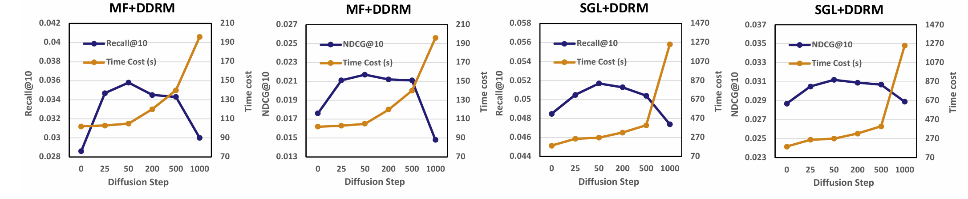
ATAI
Advanced Technique of Artificial Intelligence
ATAI
ChongqingUniversity _{AdvancedTechniqueof}
of Technology Artificial Intelligence
Chongqing University of
Technology
Chongqing University ^{ATAI}
_{of Technology} Advanced Techniqueof
Artificial Intelligence
Chongqing University of Technology
Chongqing University of Technology
Experiments

Slide 18
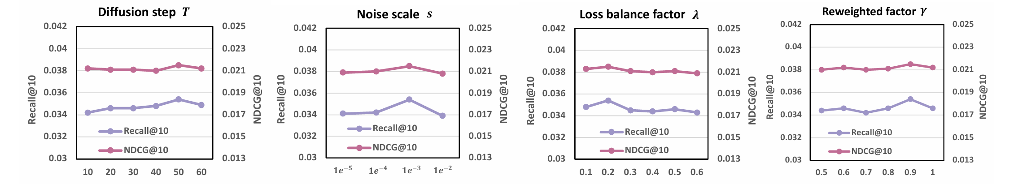
ATAI
Advanced Technique of Artificial Intelligence
ATAI
ChongqingUniversity _{AdvancedTechniqueof}
of Technology Artificial Intelligence
Chongqing University of
Technology
Chongqing University ^{ATAI}
_{of Technology} Advanced Techniqueof
Artificial Intelligence
Chongqing University of Technology
Chongqing University of Technology
Experiments

Slide 19


ATAI
Advanced Technique of Artificial Intelligence
ATAI
ChongqingUniversity _{AdvancedTechniqueof}
of Technology Artificial Intelligence
Chongqing University of
Technology
Chongqing University ^{ATAI}
_{of Technology} Advanced Techniqueof
Artificial Intelligence
Chongqing University of Technology
Chongqing University of Technology
Thanks!

